Slide 1
Game Display Team
Josiah Hertzler
Taha Siddique
Jack McFann
Tom Hoffman
Sawyer Brown

Slide 2
Bot!Battle! System
Game Evaluation
Playback Mode
Testing Mode
Contests
Web Development
Game Challenges

Slide 3
Playback Mode
View completed matches
Speed Slider
Turn by turn
Easy to use

Slide 4
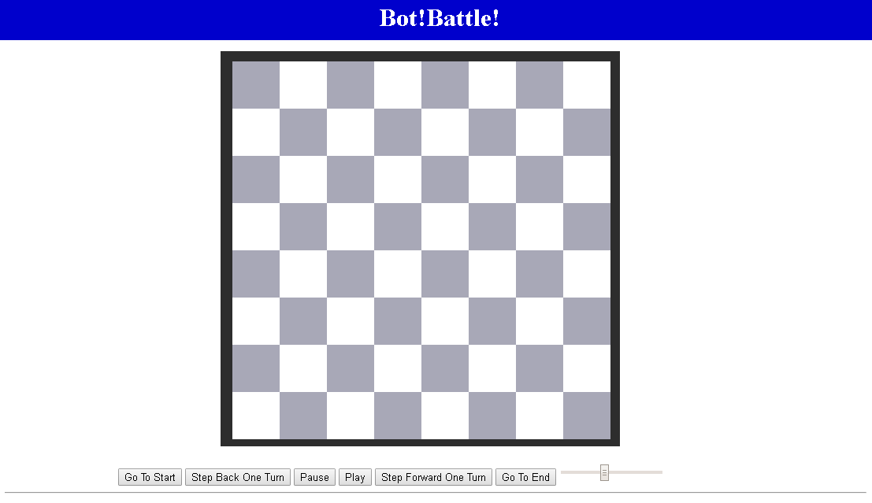



Slide 9


Slide 10



Slide 11
Testing Arena
Debugging Mode
Update bot each turn
Upload File
Edit Code
Test against other bots
Public Bot
Default Bot

Slide 12
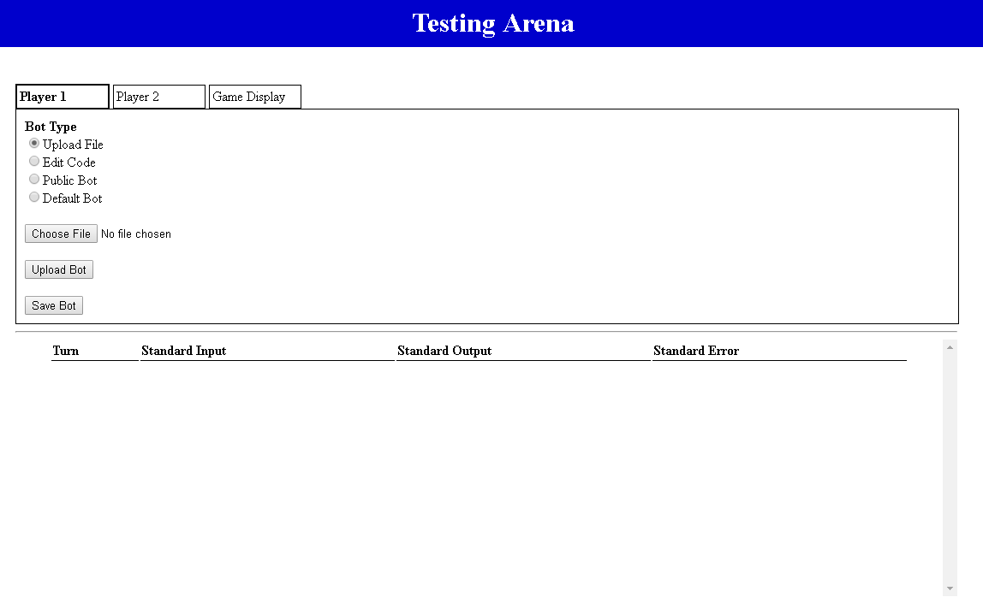

Slide 13
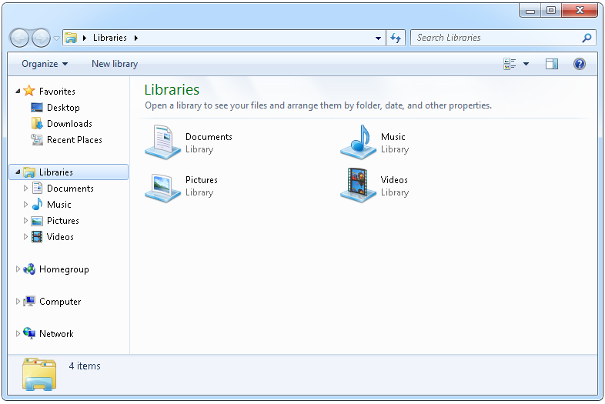

Slide 14
//Template Code for bot
public static void main(String args) {
System.out.print(“Hello!”);
}

Slide 17
Capture The Flag
Math Based Game Challenge
Balance Attack and Defense
Many layers of strategy
Aggressive vs Conservative
Attack Focus vs Defense

